Slide 1

Welcomes you all

Slide 2

Prayer

Slide 3

KIKANI VIDHYA MANDIR
PARENTS TEACHERS MEETING – 2024-2025
Grade (9 – 12)
Date: 06-06-2024
Venue : School Auditorium

Slide 4

PRAYER
WELCOME NOTE
SCHOOL TIMINGS
UNIFORM
ERP
EMPOWERING EXCELLENCE
CURRICULUM & ASSESSMENT
LANGUAGE POLICY
SKILL SUBJECTS
CBSE UPDATES

Slide 5

SCHOOL TIMINGS
8.30 am – 4.00 pm
Lunch Break – 12.00 noon to 12.30 pm

Slide 6
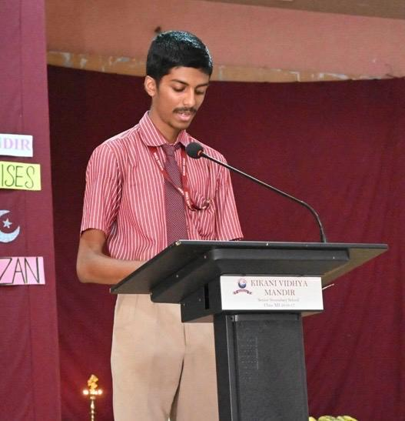
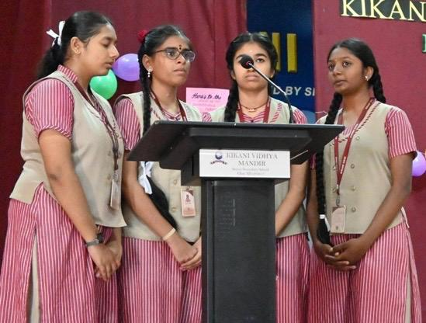
UNIFORM
Regular Uniform (Monday)
Black Shoe & Socks
Girls – Black ribbon

Slide 7

UNIFORM
Wednesday & Saturday
Tuesday

Slide 8

UNIFORM
Friday
Thursday

Slide 9

UNIFORM
Tuesday
Wed & Sat
Friday
Thursday

Slide 10
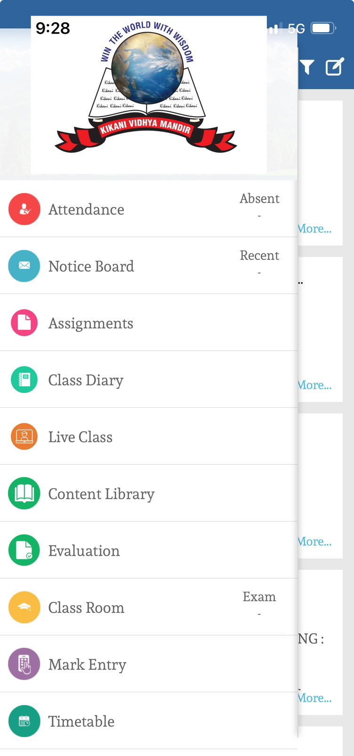

ERP

Slide 11


Results (2023- 2024)

Slide 12

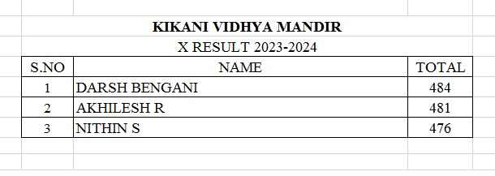
Results (2023- 2024)

Slide 13


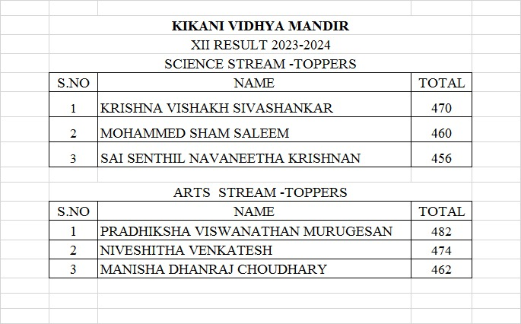
Results (2023- 2024)

Slide 14

Results (2023- 2024)
CENTUM HOLDERS
GRADE 10
DARSH BENGANI – MATHEMATICS
GRADE 12
KAVIYARANI – PSYCHOLOGY
VARSHANMITHRA – ARTIFICIAL INTELLIGENCE

Slide 15

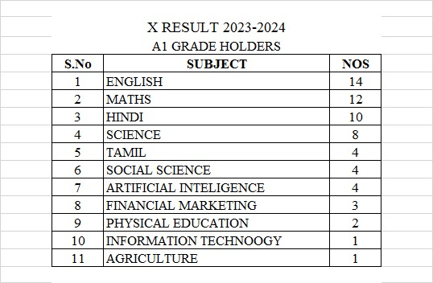

Results (2023- 2024)

Slide 16
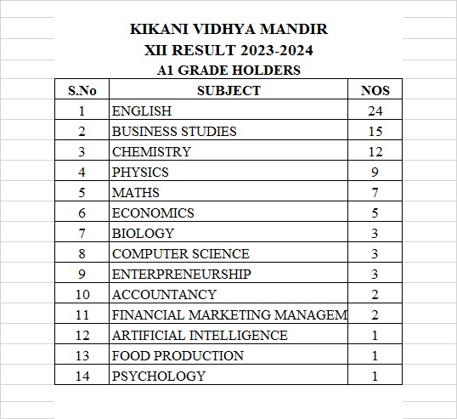


Results (2023- 2024)

Slide 17
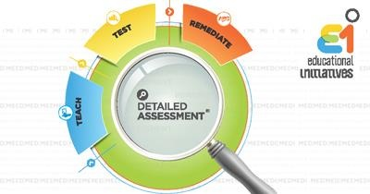
Empowering Excellence
DA aims to assess the level of comprehension of a topic among students and provide immediate feedback to teachers in order to proactively improve student performance.

Slide 18

Empowering Excellence
Mind spark is a computer-based online self-learning tool, that enhances children’s understanding of mathematical concepts, Science and English.
It adapts to each student’s individual learning pace in sync with the school curriculum and provides instant feedback that clears inadequate understanding.

Slide 19

Empowering Excellence
Robotics
Educational robotics is an effective way to introduce scientific and technological concepts in a practical and tangible way. Students can acquire knowledge of mechanics, electronics, coding and other STEM disciplines while interacting and having fun with robots.

Slide 20
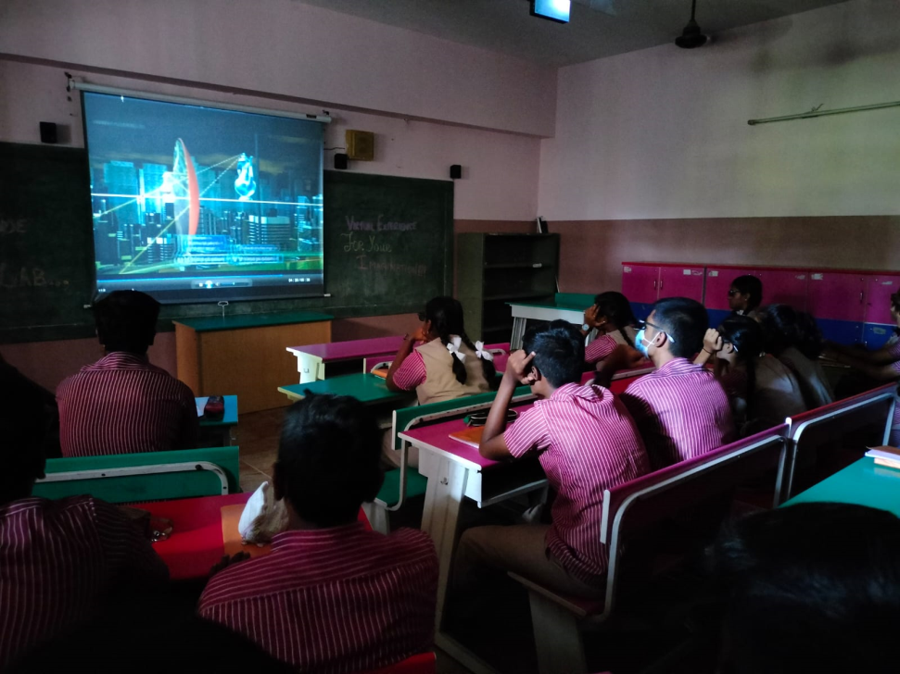
Empowering Excellence
3D lab
Learning has become even more fun than before. Students are more inclined to learn and grasp knowledge with the interesting mode of teaching.
The School has three 3-D stereo labs for viewing of Science and Math concepts and this has made a tremendous difference to the students’ learning.

Slide 21
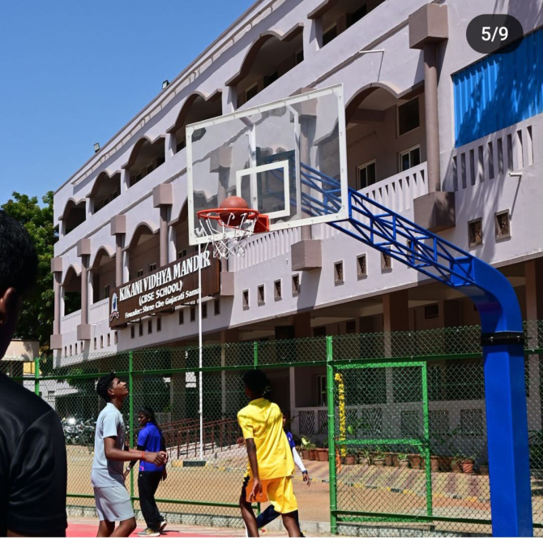
SPORTS
Basketball Court

Slide 22
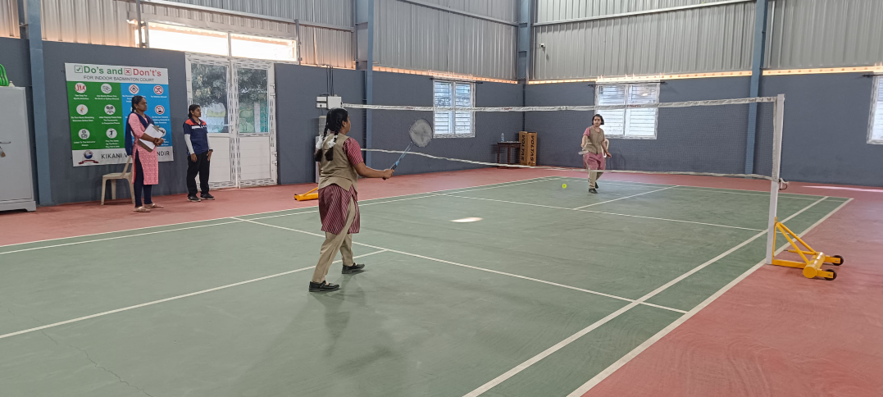
SPORTS
Badminton
Court

Slide 23
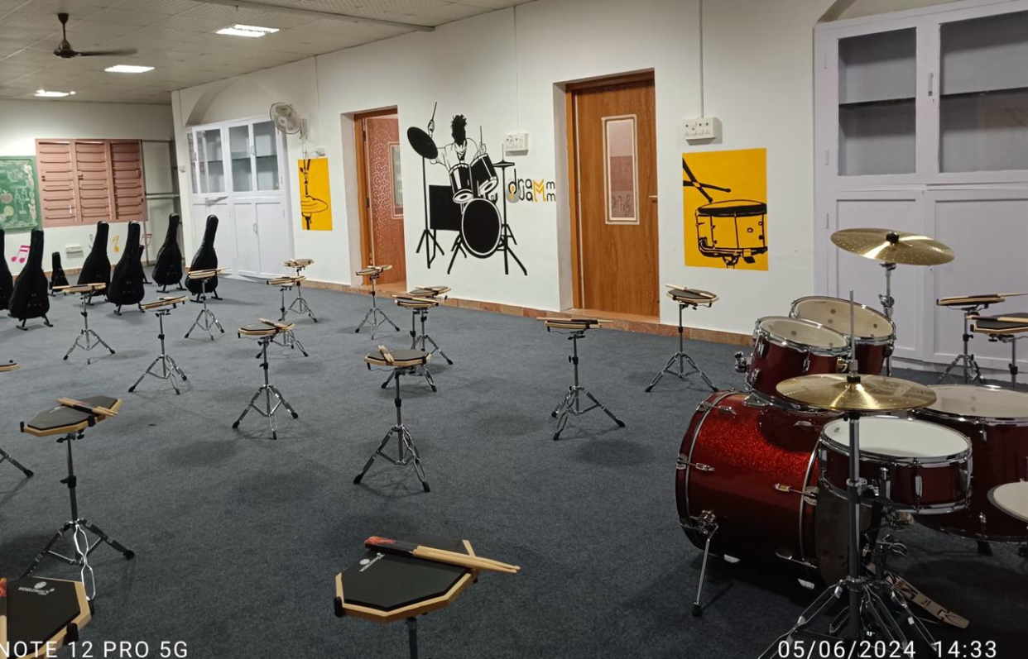
Instruments (Drums)

Slide 24
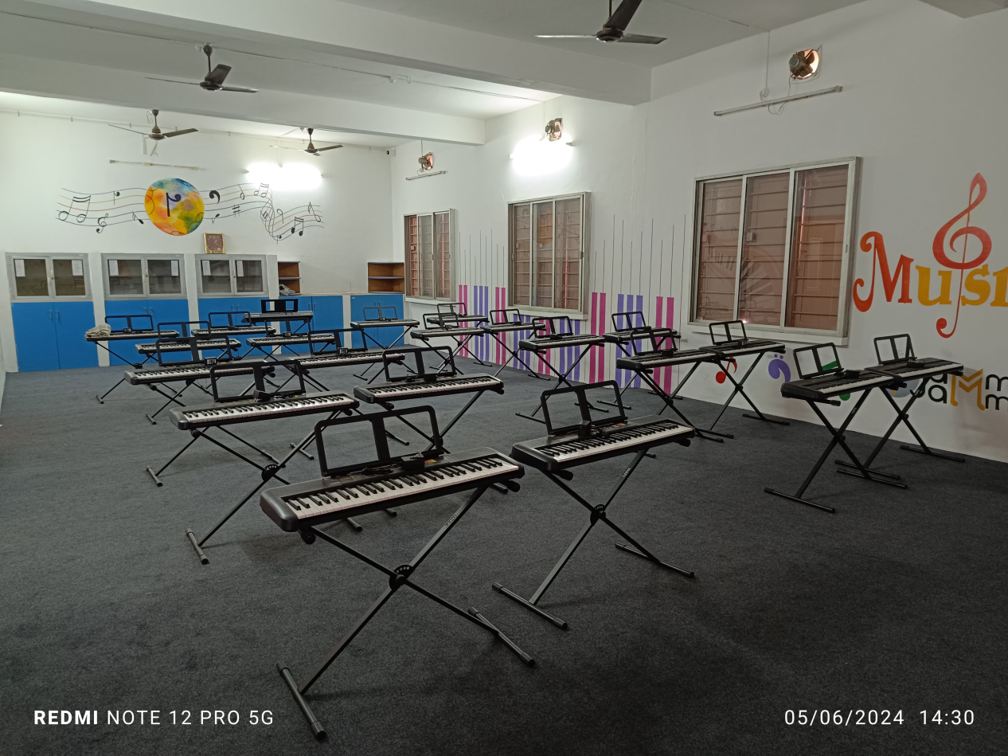
Instruments (Key board)

Slide 25

Performing Arts (Dance)

Slide 26





Club Activities

Slide 27
Grade 9 & 10 Assessment
Internal Assessment 20 marks
Term Ending Examination 80 marks

Slide 28
Internal
Assessment
Subject Enrichment Activity (5 m)
+ Multiple Assessment (5 m)
+ Portfolio (5 m)
+ Periodic Test
(3 test will be conducted – best of 2 average) (5 m)
Marks
20

Slide 29
MCQ
HOTS
Case Study
Competency based
QUESTION PAPER
PATTERN
Typology of Questions
Application/ Analyses/ Synthesis

Slide 30
SKILL SUBJECTS
Agriculture
Food Production
Design Thinking
Information Technology
Introduction to financial Markets
Artificial intelligence
Physical Activity Trainer

Slide 31

Language Policy

Slide 32
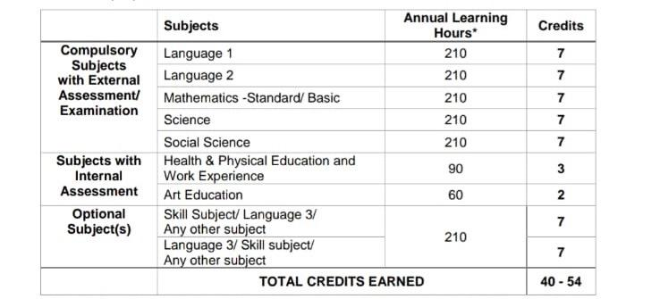
NCrF
Grade 9

Slide 33
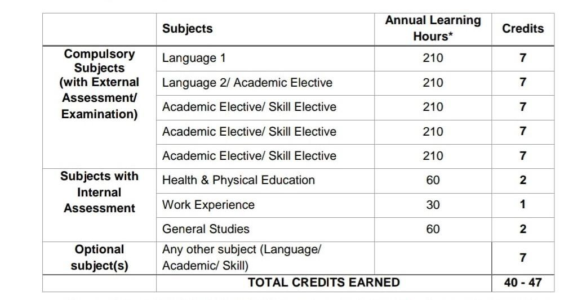
NCrF
Grade 11

Slide 34
Grade
11

Slide 35
Assessment Pattern
English | Internal Assessment + (20 m) Theory Examination (80 m)
Business Studies
Accountancy
Economics
Maths

Slide 36
Assessment Pattern
Psychology | Internal Assessment + (20 m) Theory Examination (80 m)
Legal Studies
Applied Math
Financial Market Management

Slide 37
Assessment Pattern
Physics | Internal Assessment + (30 m) Theory Examination (70 m)
Chemistry
Biology
Computer Science
Entrepreneurship

Slide 38
Assessment Pattern
Food Production | Internal Assessment + (30 m) Theory Examination (70 m)
Artificial Intelligence | Internal Assessment + (50 m) Theory Examination (50 m)

Slide 39
Typology of Questions
Competency Focused questions in the form of MCQs/Case Based Questions ,Source based Integrated Questions or any other type = 50%
Select response type questions (MCQ) = 20 %
Constructed response questions (Short Answer Questions /Long Answer Type Questions ,as per existing pattern )= 30 %

Slide 40
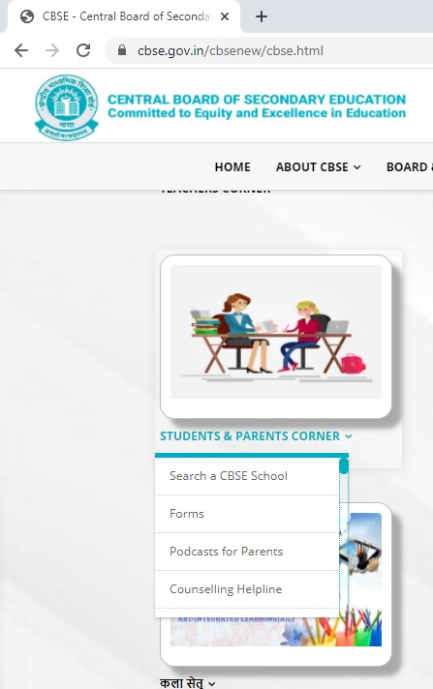
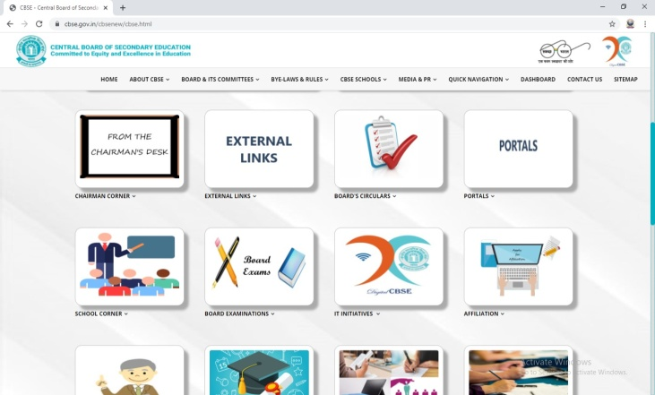
CBSE PORTAL
LINK
www.cbse.gov.in/cbsenew
How the Portal Looks
Students and Parent's Corner

Slide 41
Competitions
E- PATHSHALA
Regularly updated on CBSE website and School Website cbse.gov.in/cbsenew www.quiz.mygov.in CBSE Reading Challenge
The platform offers a slew of educational resources, including NCERT textbooks for classes 1-12, audio-visual resources by NCERT, periodicals, supplements, teacher training modules and a variety of other print and non- print materials.
CBSE INITIATIVES
DIKSHA
An initiative which leverages existing highly scalable and flexible digital infrastructures

Slide 43

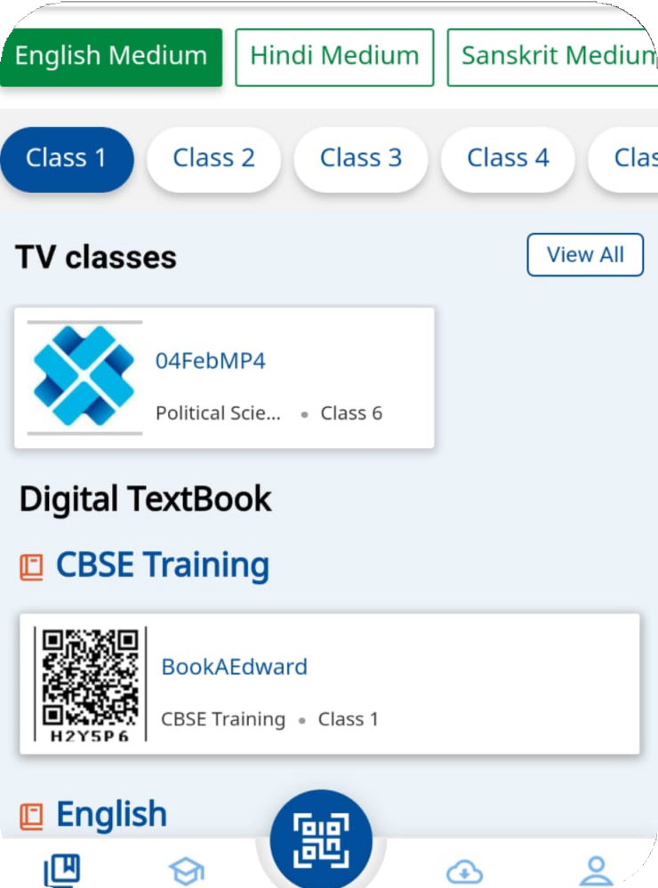
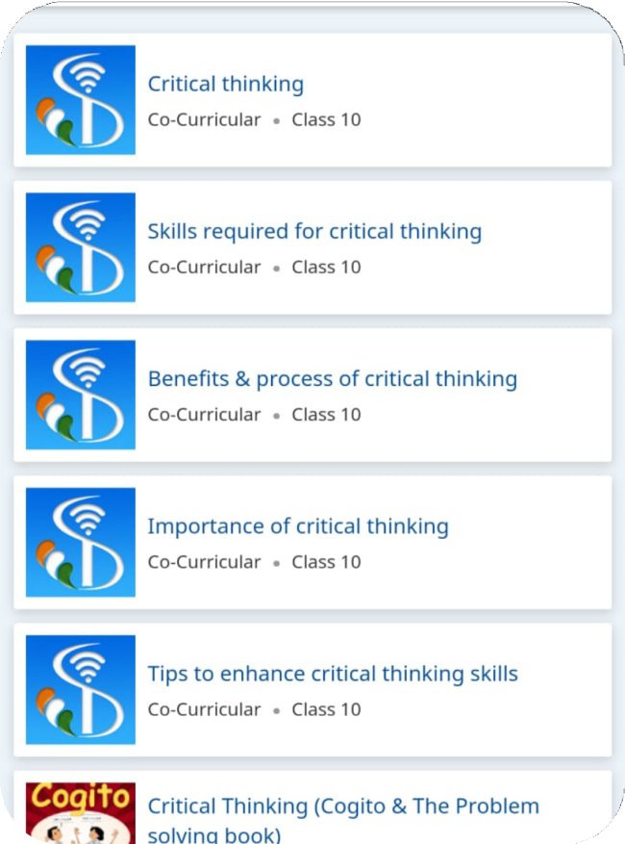
DIKSHA PORTAL

Slide 44


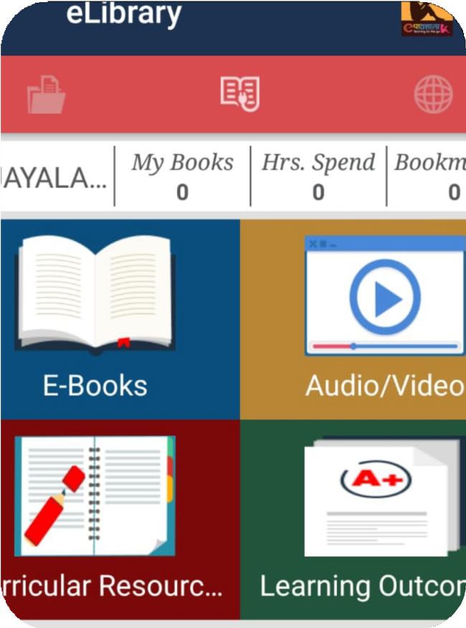
e-Pathsala PORTAL

Slide 45
Thank You

